Slide 1




THE DOM SQUAD
PORTFOLIO

Slide 2

CONTENT
01
ABOUT US
02
OVERVIEW
03
OUR SERVICES
04
FEATURES
05
TOOLS

Slide 3
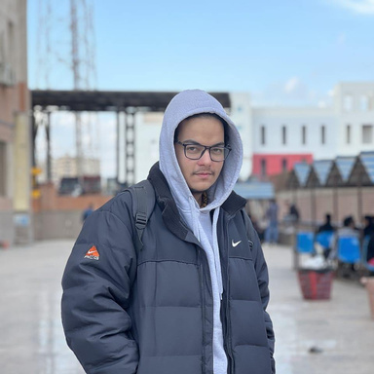
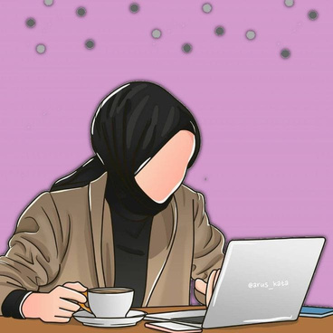

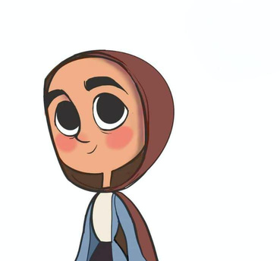
ABOUT US
Mohammed
Atef
Toqa
Tamer
Laila
Ahmed
Ashrqat
Ali
Front-End Developer
Front-End Developer
Front-End Developer
Front-End Developer

Slide 4
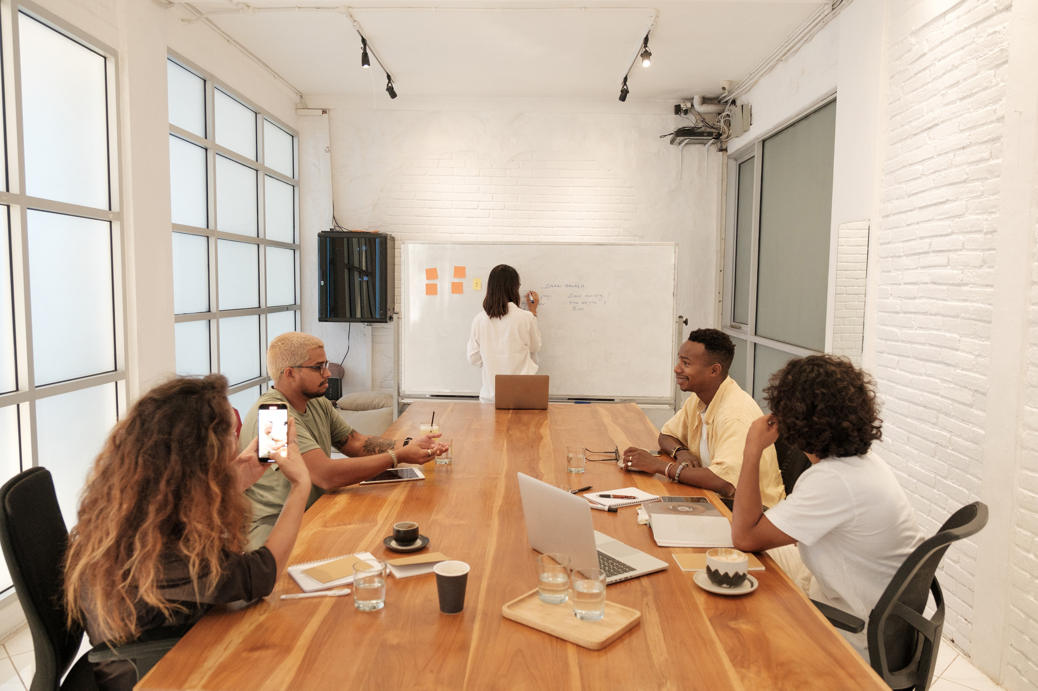


OVEREVIEW
This portfolio project was developed as part of the DEPI initiative ,The site features individual profiles for each member, highlighting their experience, projects, and contact information.
users can easily personalize the template by inputting their own details, making the portfolio a flexible tool for anyone.

Slide 5


OUR SERVICES
99%
The portfolio offers users a personalized experience through quick and easy template customization. Users can input their personal data to instantly generate a professional portfolio that showcases their skills, projects, and contact information.

Slide 6



FEATURES
The portfolios are optimized for all screen sizes and devices, ensuring a seamless user experience on desktops, tablets, and smartphones.
The portfolio template instantly updates with the user’s personal information as soon as they submit their data.
RESPONSIVE DESIGN
QUICK RESULT

Slide 7


01
02
03
HTML
CSS
JAVASCRIPT
For structuring web pages with semantic elements to enhance accessibility and SEO.
For styling and layout using Flexbox, CSS Grid, and media queries for responsiveness.
For dynamic functionality, including ES6 features like arrow functions and DOM manipulation.

Slide 8
04
05
06
BOOTSTRAP
ANGULAR
GITHUB
For responsive design, using its grid system, along with Remix Icons and Font Awesome for scalable icons.
for building dynamic, single-page applications (SPAs) that enhance user experience by loading a single HTML page and dynamically updating the content without full page reloads.
GitHub: For version control, using Git for tracking changes and GitHub Actions for automated CI/CD workflows.

Slide 9

THANK YOU
We would like to extend our heartfelt gratitude to our mentor,
Omnia Abdelhamid, for her incredible support and guidance throughout our project. Your dedication and expertise have inspired us and helped us grow as developers. Thank you for being an amazing mentor!

